Slide 1
Plate Tectonics
Evolution of the Earth

Slide 2
How do we know anything about the Earth
Interior structure
Volcanoes and hotspots
Earthquakes
Tectonic plates
Tectonic motion
Reconstruction of the Earth’s history

Slide 3
Interior

Slide 4
Interior

Slide 5
Volcanoes
Volcanoes are the result of hot spots within the crust or mantle of the earth.
The hot, liquid rock will break through weak spots in the surface and form volcanoes or flood basalts.
Many volcanoes do not release lava, instead they spit ash and small bits of lava called lapilli.
Some eruptions are quiet with very fluid (low viscosity) lava flows while others are explosive

Slide 6
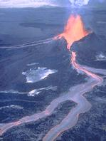
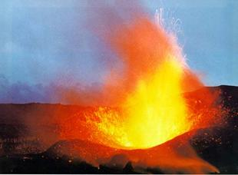
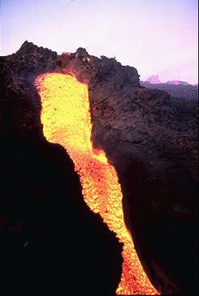
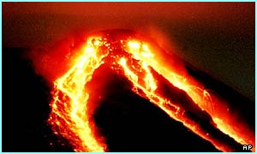
Volcanoes
Quiet
lava
flows

Slide 7
Volcanoes
Mt. St. Helen before the explosive eruption

Slide 8
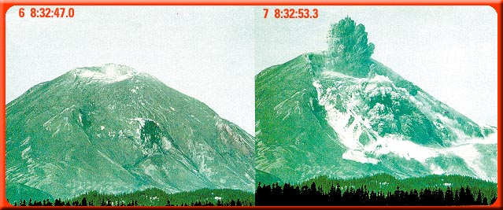
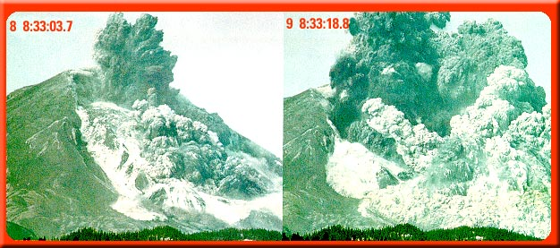
Volcanoes

Slide 9
Volcanoes
Time lapse of the eruption

Slide 10
Volcanoes
Mt. St. Helen after the eruption

Slide 11
Volcanoes
Mt. St. Helens begins the rebuilding process

Slide 12
Volcanoes

Slide 13
Volcanoes

Slide 14
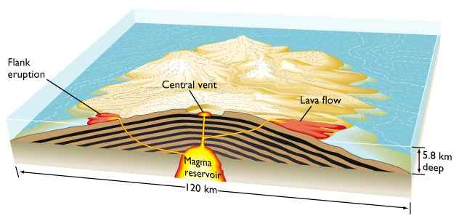
Volcanoes
Shield

Slide 15
Flood basalts

Slide 16
Volcanoes

Slide 17
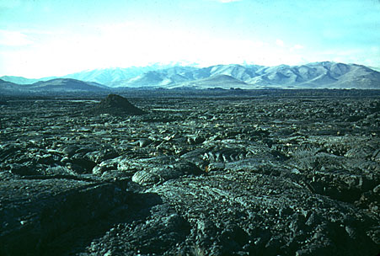
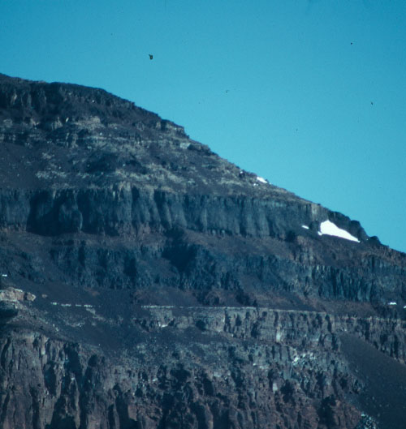
Flood basalts
Basalt is a type of rock that is
produced from the mantle

Slide 18
Volcano locations

Slide 19
Earthquakes
Earthquakes are a result of motion within the earth.
This only occurs where the earth is solid and therefore can only occur within about 100 miles of the surface
Earthquakes provide the best evidence regarding the interior structure of the Earth.

Slide 20
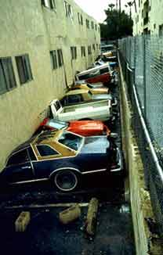
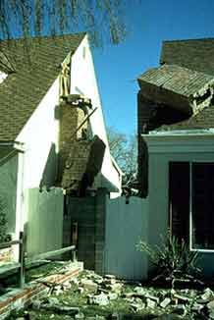
Earthquakes

Slide 21
Earthquakes

Slide 22
Earthquakes

Slide 23
Earthquakes

Slide 25
Earthquakes

Slide 26
Earthquakes

Slide 27
Earthquakes

Slide 28
Earthquakes
Tidal waves or Tsunamis result when a large section of the sea floor
suddenly moves and therefore displaces a massive amount of water.

Slide 29
Earthquakes
Tidal waves or Tsunamis result when the low amplitude long wavelength waves
reach the shallow shoreline and begin to feel the bottom of the sea floor. This
Shortens the wavelength and increase the amplitude (height).

Slide 30
Earthquakes
Location of worldwide earthquakes

Slide 31
Earthquakes
Earthquakes by depth.
Notice that the deep earthquakes occur only at subduction zones.

Slide 32
Tectonic Plates

Slide 33
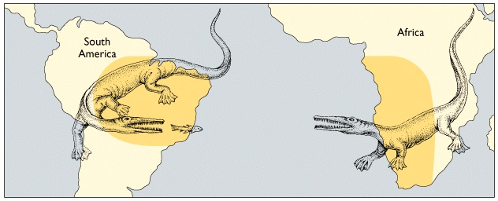
Tectonic Plates
Our first evidence of tectonic motion is based on similar fossils and
rock types on opposing sides of the ocean

Slide 34
Tectonic Plates

Slide 35
Tectonic Plates
Today plate boundaries are determined by examining
the location of volcanoes and earthquakes.
Volcanoes result from the friction (heat) of the plates
motion.
Earthquakes occur where plate rub against one another

Slide 36
Tectonic Plates
Volcanoes

Slide 37
Tectonic Plates

Slide 38
Tectonic Plates

Slide 39
Tectonic Plates

Slide 40
Tectonic Plates

Slide 41
Tectonic Plates
Another source of
evidence is based
on seafloor ages
which get younger
as we approach
sea floor ridges

Slide 42
Tectonic Plates
Our final piece of
evidence is the
magnetic record
of the ocean floor.
This shows the
pattern of reversal
and we find a near
perfect mirror image
on opposing sides
of the ridge

Slide 43
Tectonic Plates

Slide 44
Tectonic Plates

Slide 45
Tectonic Plates

Slide 46
Composition vs. Motion
We can look at the interior of the Earth based
on the composition of the rocks or based on the movement

Slide 47
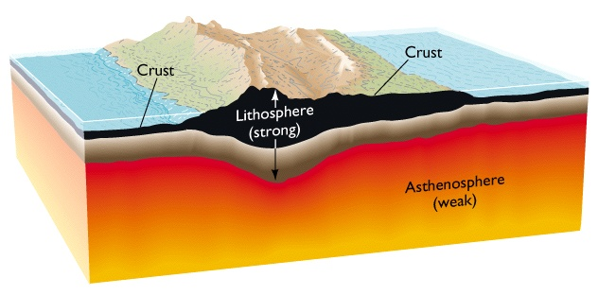
Based on Composition
Crust – solid, relatively low density silicate rock
Mantle – Semi fluid, denser, mafic (iron and magnesium bearing) rocks
Core – Liquid then solid iron and nickel with traces of heavier elements

Slide 48
Based on Motion
It turns out that the upper section of the mantle is adhered (stuck to the underside side of the crust to form what we call tectonic plates

Slide 49
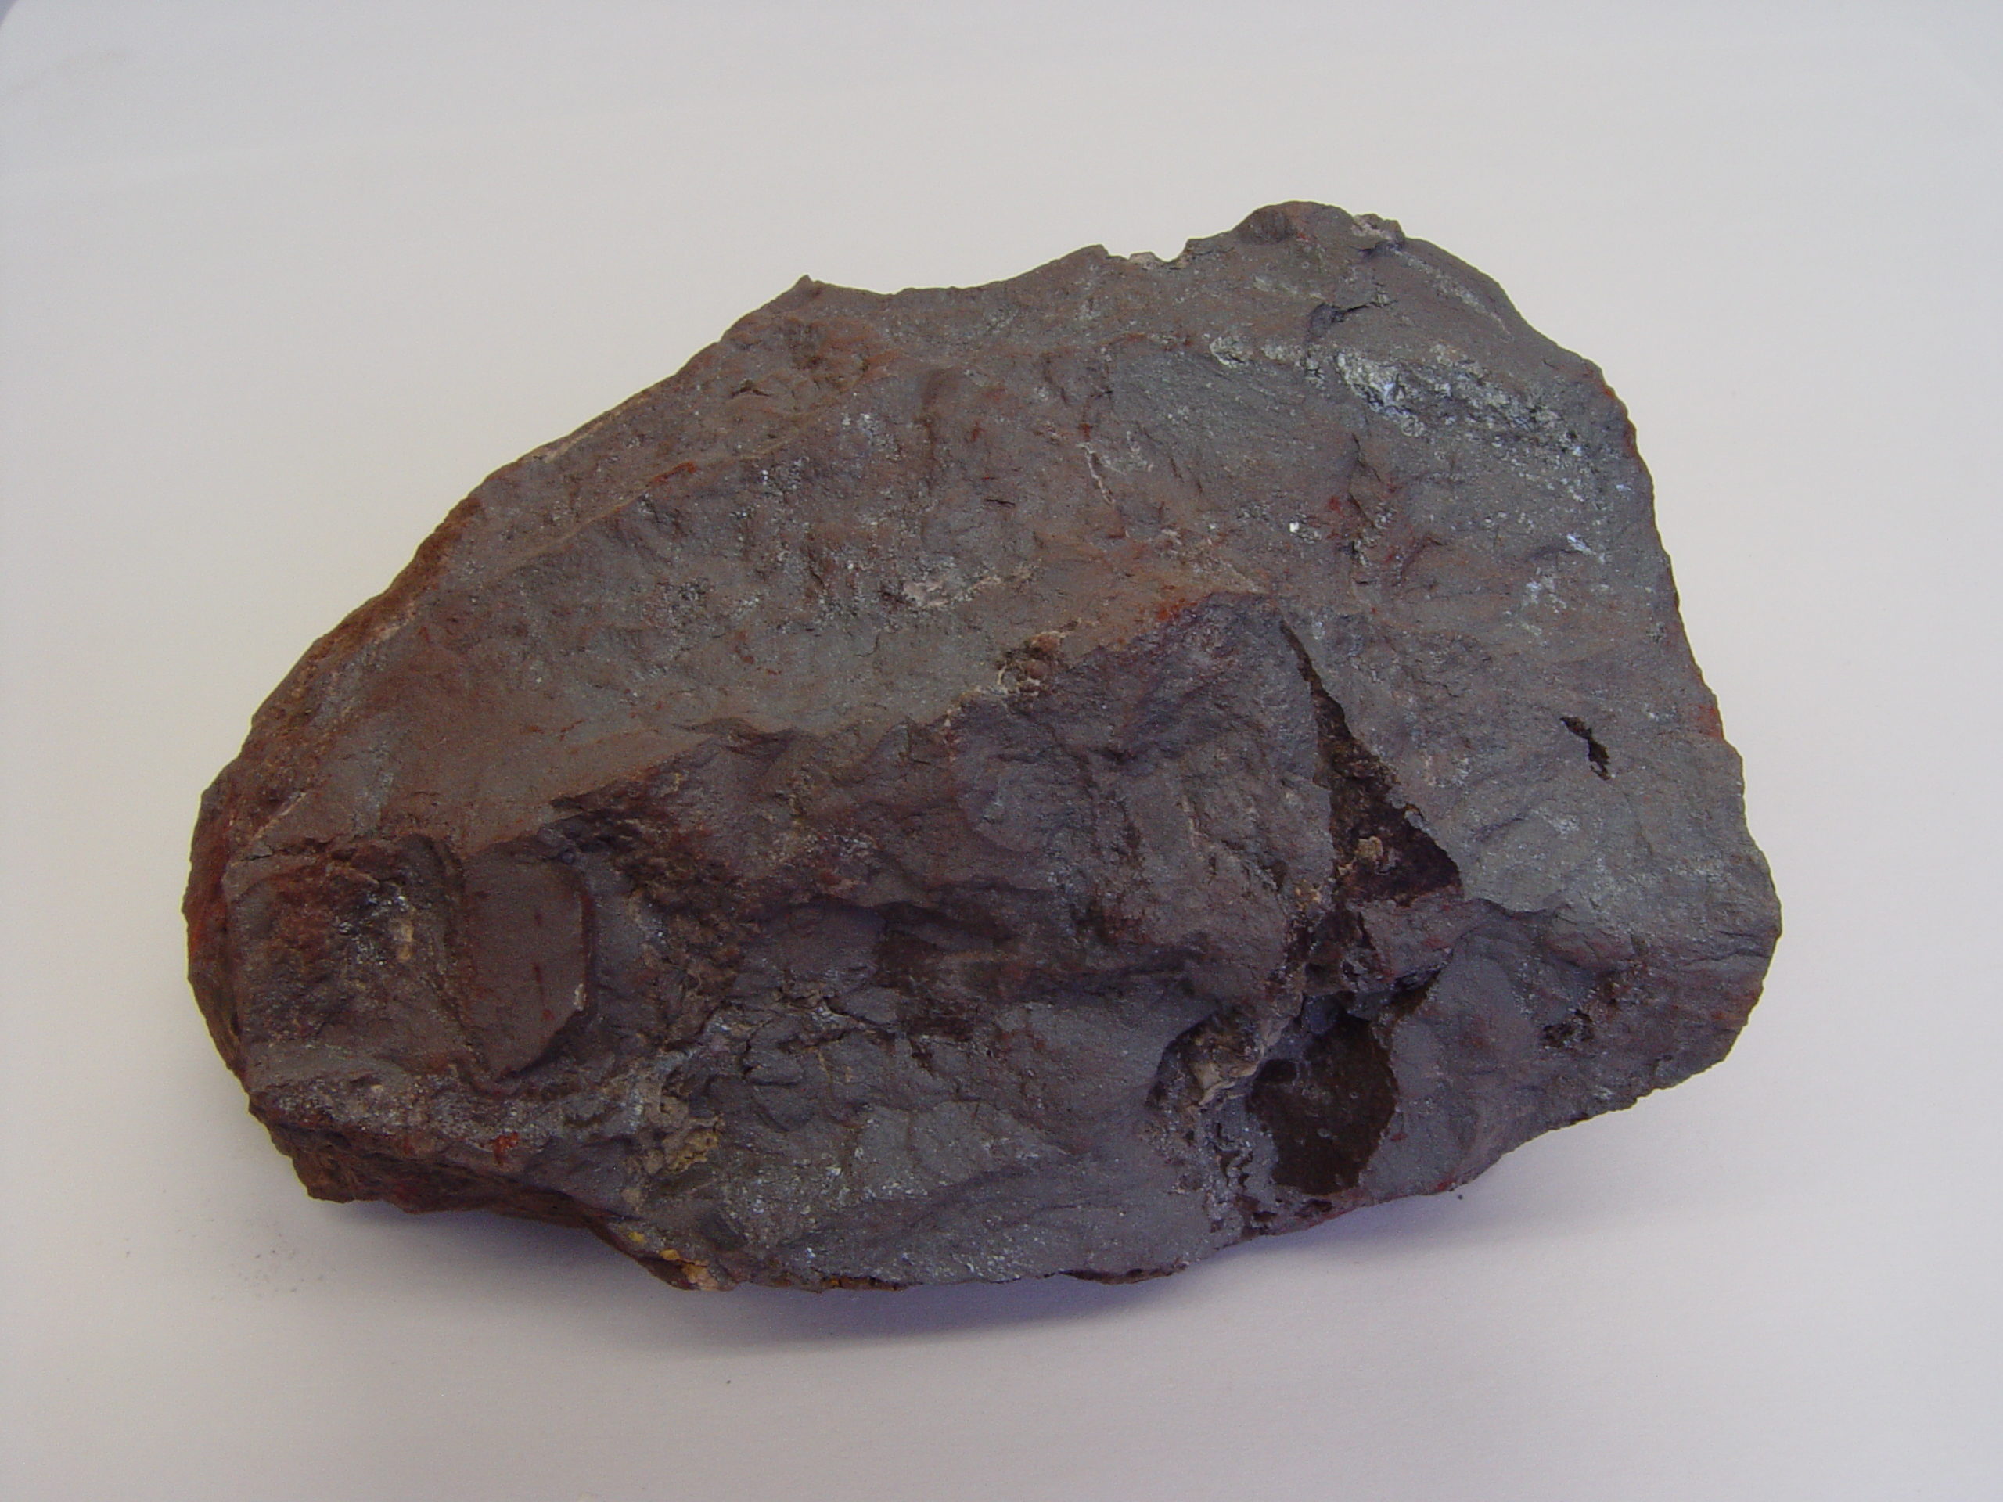
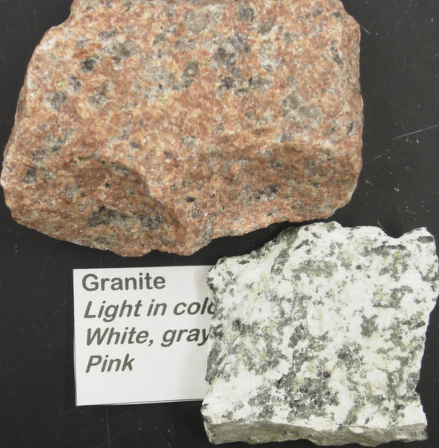
Plate Types
Oceanic plates: basalt
Dark (black) and dense rock type composed of silicates, iron and magnesium
Continental plates – granite and andesite
Light colored (pink, white and gray) and low density rock type composed almost entirely of silicates.

Slide 50
Plate Boundaries
Convergent – plates move toward one another
Divergent – plates move away from each other
Transform – plate moves sideways from each other

Slide 51
Plate Boundaries

Slide 52
Plate Boundaries

Slide 53
Convergent Plates

Slide 54
Convergent Plates

Slide 55
Convergent Plates

Slide 56
Convergent Plates
The only subduction zone
in the Atlantic

Slide 57
Convergent Plates
Black arrows show subduction zones and
the direction of plate movement

Slide 58
Convergent Plates
Looking at the depth
of earthquakes shows
that angle that the
plate is being subducted

Slide 59
Divergent Plates

Slide 60
Divergent Plates

Slide 61
Divergent Plates

Slide 62
Divergent Plates

Slide 63
Transform Plates

Slide 64
Transform Plates
San Andreas
Fault

Slide 65
Mid-Plate Hotspots

Slide 66
Mid-Plate Hotspots

Slide 67
Mid-Plate Hotspots

Slide 68
Mid-Plate Hotspots

Slide 69
Why do the Plates Move?

Slide 70
Why do the Plates Move?
No single idea explains everything but we can identify several forces that contribute to the movement of the plates.
Slab pull
The sinking of the cooled dense oceanic plates pulls on the rest of the plate
Ridge rises
The material deposited on the top of the ridge slides downs from the rise pushing on the plate
Convection
Movement within the mantle could be part of the driving force behind the motion of the plates.

Slide 71
The Big Picture

Slide 72
Pangea
What is Pangaea?
Pangaea was a super continent at one time.
Scientists use the similarity of rock types and fossil types that date to the same age to support their theory that the continents were connected to form a super continent.
The map below give just one example of areas on different continents that show the same fossils and rock types.

Slide 73
Pangea

Slide 74
Pangea

Slide 75
Pangea
The break up
of Pangea

Slide 76
Where are we going?
We appear to be headed for another
super continent as North America,
South America, Asia and Australia converge in the
ever shrinking Pacific Ocean

Slide 77
This powerpoint was kindly donated to www.worldofteaching.com
http://www.worldofteaching.com is home to over a thousand powerpoints submitted by teachers. This is a completely free site and requires no registration. Please visit and I hope it will help in your teaching.

